Slide 1


Slide 2

Asynchronous event
Signals can be sent to process by
  Kill system call by another process
  Kernel can send signals to process
Notes:
A signal is an event generated by the UNIX and Linux systems in response to some condition, upon receipt of which a process may in turn take some action.
Signal is an asynchronous event. A process can receive a signal either by another process using the kill system call or when the kernel sends the signal to a process.

Slide 3

When a process receives a signal, the operating system uses a mechanism to notify the process about the occurrence of the signal.
The key steps involve setting a bit in the process's signal mask and scheduling the process for a signal handling routine
How a process receives a signal
  Kernel will set the respective bit in process entry table
A signal is generated either by the kernel or as a result of some event, such as a hardware interrupt or another process sending a signal using the kill command
When process will handle a signal?
  When process returns from kernel mode to user mode
  After the signal handler completes its execution, control returns to the normal execution of the process.
Notes:
From the signal generation side, whenever a process or kernel wants to send a signal to a process, kernel will set the bit of that particular signal in its process entry table. If more than one signal is generated for a process, the respective bits of those signals are set. But, the number of instances, that signal is generated cannot be know with this.
On the other side, the signal for a process is handled, only when a process returns from kernel mode to user mode. Thus, a signal doesn’t have any instant effect on a process running in kernel mode.
Consider for an example, If a process is running in user mode, and the kernel handles an interrupt that causes a signal to be sent to the process, the kernel will recognize and handle the signal when it returns from the interrupt. Thus, a process never executes in user mode before handling outstanding signals.

Slide 4
Signal Arrival:
A signal is generated either by the kernel or as a result of some event, such as a hardware interrupt or another process sending a signal using the kill command
Signal Delivery:
The kernel identifies the target process for the signal based on the process ID (PID) or other criteria.
The kernel sets a flag or bit in the process's signal mask to indicate the arrival of the signal.
Process Scheduling:
If the process is currently executing, the kernel schedules it to handle the signal at a convenient point. If the process is not currently running, the signal is held until the process becomes runnable.
Context Switch:
When the process is scheduled to run or returns from a blocking system call, the kernel initiates a context switch, transferring control to the process.
Signal Handling:
Before the process resumes normal execution, the kernel checks the signal mask. If the signal is unblocked, the kernel arranges for the signal handler associated with the received signal to be executed.
Execution of Signal Handler:
The process executes the signal handler function, which is a user-defined routine designed to handle the specific signal. The handler can perform actions like cleanup, logging, or custom processing based on the type of signal received.
Return to User Mode:
After the signal handler completes its execution, control returns to the normal execution of the process.

Slide 5

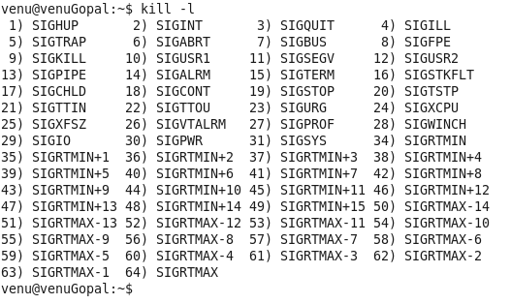
The command ‘kill –l’ lists all the signals that are available.
Notes:
The list of all available signals can be found from kill –l command.
Among the list, some of them are
SIGINT: This signal is generated, when a ctrl+c is given through the keyboard.
SIGSEGV: This is generated when there is some segmentation problem, related to memory
SIGPIPE: if the reading end of a pipe is closed and we are writing at the other write pipe end
SIGCHLD: This signal is sent by the child process to its parent before exiting
SIGSTOP: This signal is generated by ctrl-z

Slide 6

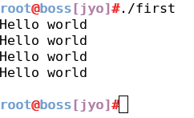
#include<stdio.h>
int main()
{
while(1)
{
printf("Hello world\n") ;
sleep(1) ;
}
return 0 ;
}
A program that prints “Hello world” every sec.
ctrl+c is the signal SIGINT number 2 in the list, to kill a program through keyboard
Output:
Notes:
Consider a simple program which prints “ Hello world” after every sec. Program is put in a while loop so that this gets printed every sec.
To, stop this program from running, we can send an external signal through keyboard using “ctrl+c” keys.

Slide 7

Consider a program with parent and child process.
Child will be in a while one loop printing “Hello world” after every sec
Parent process sends the signal using ‘kill’ system call.
Syntax:
  int kill(pid_t pid, int sig);
  Example:
    Kill(6358, SIGINT) ;
Notes:
We will extend the previous program where instead of sending the signal through the keyboard, we will send it through a process using ‘kill’ call.
Kill call takes 2 arguments, pid of the process to whom the signal is to be sent and the signal that is to be sent.

Slide 8
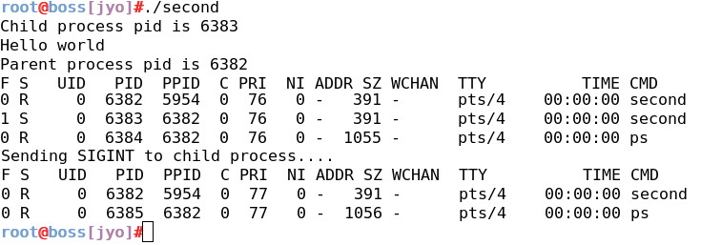
#include<stdio.h>
#include<sys/types.h>
int main()
{
pid_t cpid ;
int status ;
cpid = fork() ;
if(cpid == 0) // child process
{
printf("Child process pid is %d\n", getpid()) ;
while(1) {
printf("Hello world\n") ;
sleep(1) ;
}
}
else //parent process
{
printf("Parent process pid is %d\n", getpid()) ;
system("ps -al") ;
printf("Sending SIGINT to child process....\n") ;
kill(cpid, SIGINT) ;
wait(&status) ;
system("ps -al") ;
}
return 0 ;
}
Parent process
Child process
Parent process
Notes:
Here in this program, we have a child process running in a while(1) loop continuously. The pid of the child process is available with the parent process. Parent process sends a signal using the pid of the child. After receiving this signal, Child process gets killed. Details are known when using ps –al command. Brown colour shows the process list before sending the signal, and the details in green is after sending the signal, child process is killed.

Slide 9

Kernel handles the signals in context of a process
Three ways in handling the signals
  Ignores the signal
  Execute the default action (exit is the default action)
  Execute a user defined signal handler.
Notes:
In the previous slide, we have seen the list of signals available in the system.
Whenever a signal is generated, kernel handles this signal in the process context. Signals can be handled in 3 ways.
Ignoring the signal
Process can exit on receiving a signal, default action
Or executing a user defined signal handler.
Default action is executed when ever a signal is generated.
But, if you want to ignore or execute a user defined signal handler, we need to implement a signal handler for that signal.

Slide 10

Signal call
  To register a user defined signal handler
  To ignore a signal
  Syntax:
Three ways to register and handle
  Signal(signal_number, SIG_IGN)
  Signal(signal_number, SIG_DFL)
  Signal(signal_number, signal_handler)
Notes:
In order to execute a user defined signal handler or to ignore a signal, we register a signal handler for a particular signal.
Looking at the syntax:
Signal(int signo, int function)
Signo – signal number for which we want to register a signal handler,
Function – is the signal handler.
Looking at the 3 ways of handling the signals, using the signal call,
SIG_IGN – to ignore the signal that is associated with signal_number.
But, SIGKILL and SIGSTOP are the two signals that cannot be caught nor ignored.
SIG_DFL – Execute the default action associated with the signal_number
Signal_handler – execute a user defined signal handler for that signal_number

Slide 11
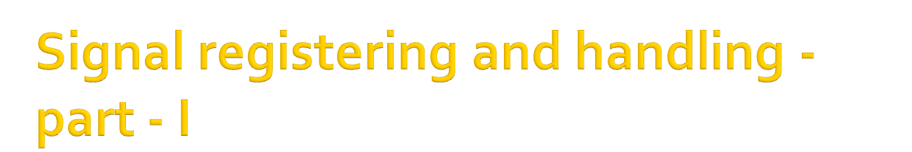
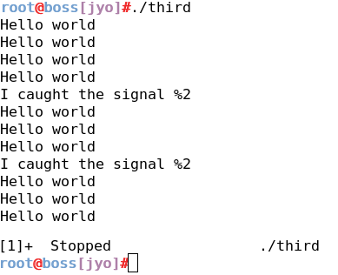
#include<stdio.h>
#include<signal.h>
void signal_handler(int signum)
{
printf(“I Caught the signal %d\n",signum) ;
}
int main()
{
(void) signal(SIGINT, signal_handler) ;
while(1)
{
printf("Hello world\n") ;
sleep(1) ;
}
return 0 ;
}
Signal handler
Registering the signal handler for SIGINT
Notes:
Modifying the previous program, let us register a signal handler for SIGINT, ctrl+c signal.
Also we will write a signal handler for that signal.
To register a signal handler
(void)signal(SIGINT, signal_handler)
First argument is the signal number and the second argument is the signal handler function pointer.
Here, signal is SIGINT, and the function is signal_handler.
The signal handler function takes the argument, signal number.
Here in this example, we demonstrate the signal registration and handling the signal.
When program is executing, first time when a ctrl+c is sent to the program, the signal is handled in the signal handler. Second time when a ctrl+c is sent, it still prints the statement in the handler and continues working. Now we cannot kill this through a ctrl+c command. Instead we can do two things.
Stop it from running using ctrl+z
Kill it through command line by ‘ kill -9 process_id’’. This kill command takes 2 arguments like the system call. First one is the signal number, -9 indicates, SIGKILL which can never be caught nor ignored. And the second argument is the process id.
I have demonstrated case 1, stopping the process from running.

Slide 12

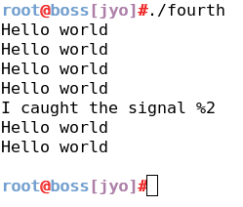
#include<stdio.h>
#include<signal.h>
void signal_handler(int signum)
{
printf("Caught the signal %d\n",signum) ;
signal(SIGINT,SIG_DFL) ;
}
int main()
{
(void) signal(SIGINT, signal_handler) ;
while(1)
{
printf("Hello world\n") ;
sleep(1) ;
}
return 0 ;
}
Signal handler
Reverting to the default behavior
Registering the signal handler for SIGINT
Notes:
Modifying the previous program, let us register a signal handler for SIGINT, ctrl+c signal.
Also we will write a signal handler for that signal.
To register a signal handler
(void)signal(SIGINT, signal_handler)
First argument is the signal number and the second argument is the signal handler function pointer.
Here, signal is SIGINT, and the function is signal_handler.
The signal handler function takes the argument, signal number.
Here in this example, we demonstrate the signal registration and handling the signal. In the signal handler, we once again revert the signal handler of SIGINT to the default behavior by
Signal(SIGINT, SIG_DFL);
So second time when the SIGINT is sent, it executes the default behavior of SIGINT.
When program is executing, first time when a ctrl+c is sent to the program, the signal is handled in the signal handler and the we put back the handler of the signal SIGINT to its default behavior. Second time when a ctrl+c is sent, it behaves its default behavior, kills the program.

Slide 13

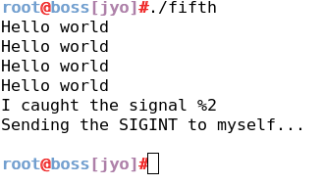
#include<stdio.h>
#include<signal.h>
void signal_handler(int signum)
{
printf("Caught the signal %d\n",signum) ;
signal(SIGINT,SIG_DFL) ;
printf(“Sending the SIGINT to myself…\n”) ;
kill(getpid(), SIGINT) ;
}
int main()
{
(void) signal(SIGINT, signal_handler) ;
while(1)
{
printf("Hello world\n") ;
sleep(1) ;
}
return 0 ;
}
Signal handler
Reverting to the default behavior
Sending the signal to itself
Registering the signal handler for SIGINT
Notes:
Extending the previous program where we are sending the signal second time through keyboard, we will send the signal through ‘kill’ call in the handler itself.

Slide 14

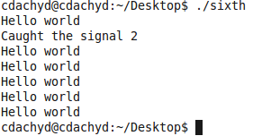
int main()
{
(void) signal(SIGINT, signal_handler) ;
pid_t pid ;
pid = fork() ;
if(pid == 0) // child process
{
while(1)
{
printf("Hello world\n") ;
sleep(1) ;
}
}
else // parent process
{
kill(pid,SIGINT) ;
sleep(5) ;
kill(pid,SIGINT) ;
}
return 0 ;
}
#include<stdio.h>
#include<signal.h>
#include<sys/types.h>
void signal_handler(int signum)
{
printf("Caught the signal %d\n",signum) ;
signal(SIGINT,SIG_DFL) ;
}
Notes:
Let us extend the previous program to include a scenario of a parent and child process, child process will be running in a while(1) loop printing “Hello world” and parent process tries to send the SIGINT signal to its child using the function kill.
We use fork to implement the scenario of a parent and child. Fork returns the pid of the child if it returns successfully. So, the child pid is available with its parent.
Now, let us look at the kill call, first argument is the pid of the process to whom the signal is to be sent and the second argument is the signal that is to be sent. Here, we get the pid from the fork call and the signal that we send is SIGINT. (in the previous example, we sent this signal using keyboard ctrl+c)

Slide 15

“The Design of the UNIX operating system” – Maurice J. Bach

Slide 16


